Slide 1

AE668 : Computation Aeromechanics and Control of UAV
Individual Project Presentation
By :
Dharshan S Hegde
M.Tech UAS - 241010078
dharshans24@iitk.ac.in

Slide 2
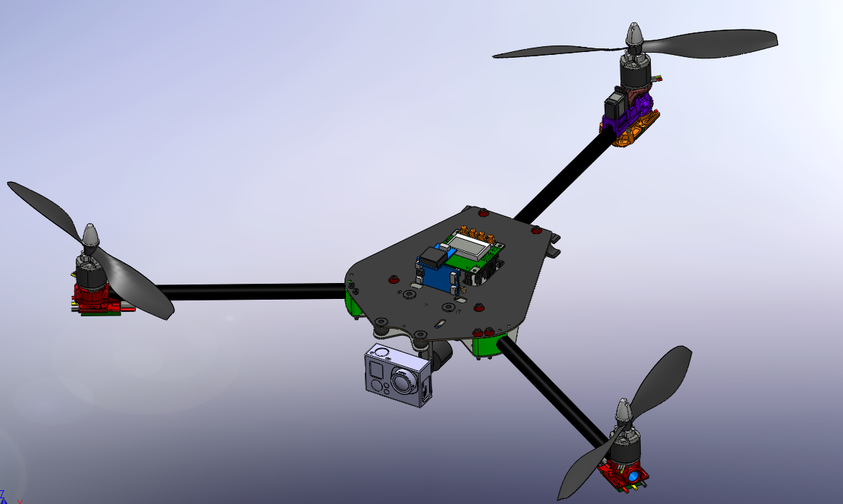
Design of tricopter for detection of cracks in high rise structures

Slide 3
Table of Contents
Introduction
Performance and Weight Estimation
Control Aspect of Tricopter
Structural Analysis
Conclusion

Slide 4
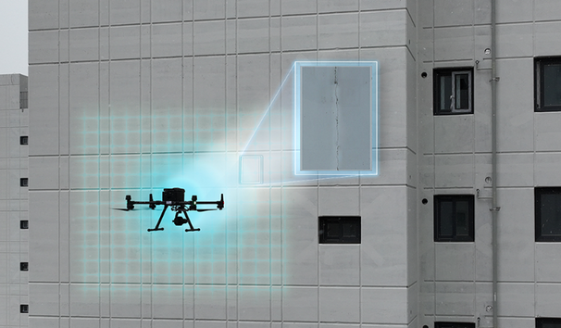
Introduction
Buildings or high bridges usually develop cracks due to its inability to withstand stress in the components over a period of time or due to natural calamities such as earthquakes.
Detecting cracks during the early stage helps in longing the lifespan of the building and avoid catastrophic collapses. Detecting cracks is done as visual inspection by inspectors, which are usually time consuming, erroneous, dangerous and expensive.
In order to monitor all the elements of the high raised buildings, ensure the safety of the inspector and to revise the crack images in various angles, drones can be used.
Source : POSCO
Objectives :
Design a tricopter having an endurance of 30 min and can lift 200 grams of payload
Describing the preliminary design process for building of a tricopter for the required payload like performance , control and structural parts.
Different trajectory maneuvers and its response for the designed tricopter.

Slide 5
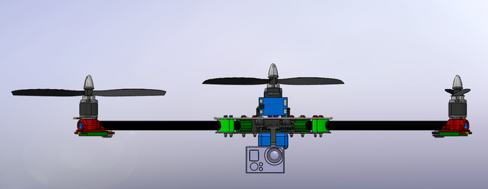
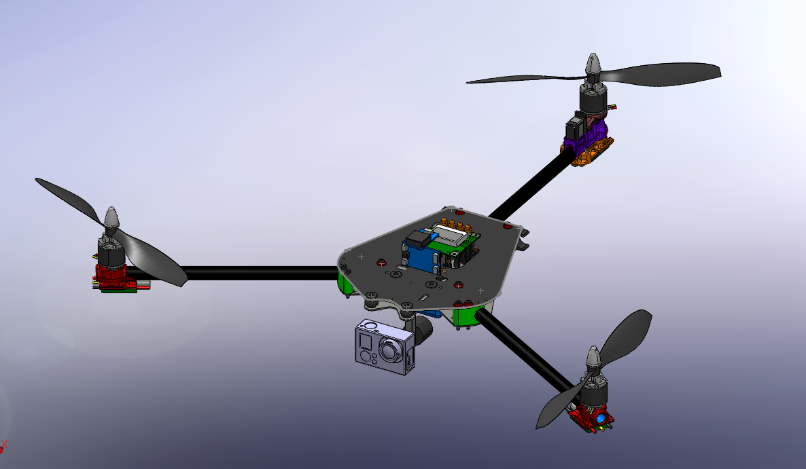
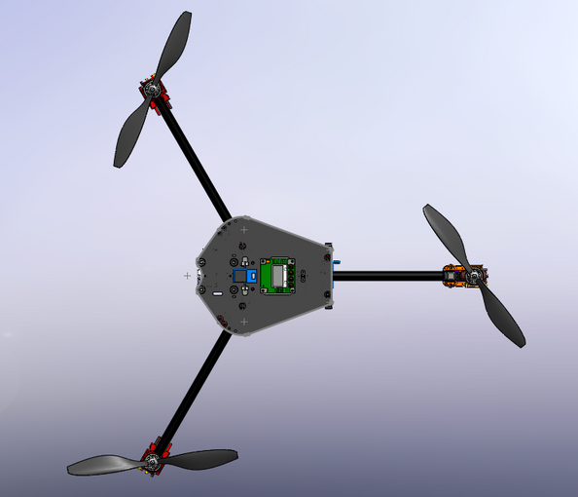
CAD Design
Frame
Servo
Controller
Current Design :
Configuration : Tricopter
Shape : Y Shaped (120 degrees apart)
Arm Length : 250 mm
Servo Control for yaw motion
Motor
Camera & Gimbal
Propeller
Support Rod

Slide 6
Performance & Weight Estimation

Slide 7
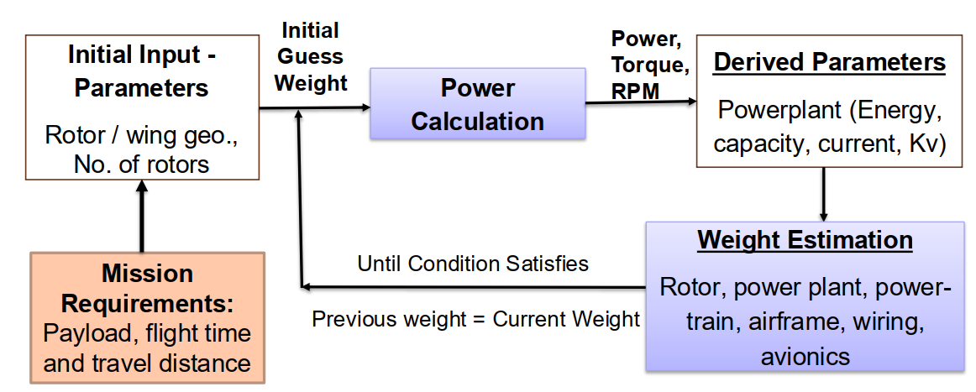
Performance Estimation
The hover performance of the tricopter is determined using Blade Element Momentum Theory .
Using BEMT we obtain different parameters of performance which includes C_T (Thrust Coefficient) , C_Q (Torque Coefficient) & Figure of Merit .
Parameters considered :
Rotor Radius - (0.1 m to 0.2 m)
Number of blade in each rotor - 2
Endurance - 30 min
Payload Weight = 200 grams
RPM Variation - 3000 to 7000

Slide 8
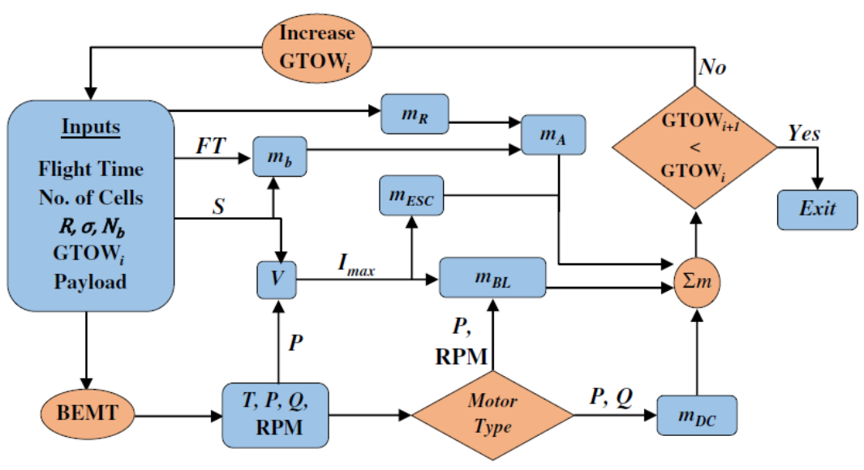
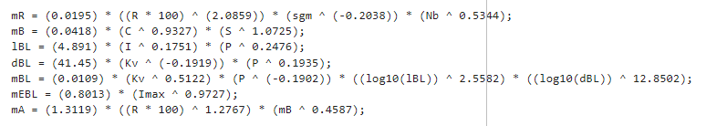
Weight Estimation
Inputs :
R - Total radius [m]
R_cut - Cut-off radius [m]
sgm - Rotor solidity
Nb - Number of blades
C - Battery capacity [mAh]
S - Number of cells
I - Max req. current for motors [A]
P - Max rated output power [Watts]
Kv - Motor speed constant [Rev Per Min Per Volt]
Imax - Max sustainable current through ESC [A]
Outputs:
mR - Rotor mass [g]
mB - Battery mass [g]
mBL - BLDC motor mass [g]
mEBL - ESC mass for BLDC motors [g]
mA - Airframe mass [g]
Source : Winslow, J., Hrishikeshavan, V., & Chopra, I. (2018). Design methodology for small-scale unmanned quadrotors. Journal of Aircraft, 55(3), 1062–1070. https://doi.org/10.2514/1.C034483​

Slide 9
BEMT Parameters | BEMT Parameters
Number of blades in each rotor | 2
Number of rotors | 3
Battery | 4S
Rotor radius | 0.12 m
Total Thrust | 7.3
RPM | 5300
Hover Power | 29 W
Endurance | 30 min
Gross Weight | 730 grams
Figure of merit | 0.846
Thrust Coefficient | 2.654 * 10^-3
Torque Coefficient | 1.142 * 10^-4

Slide 10
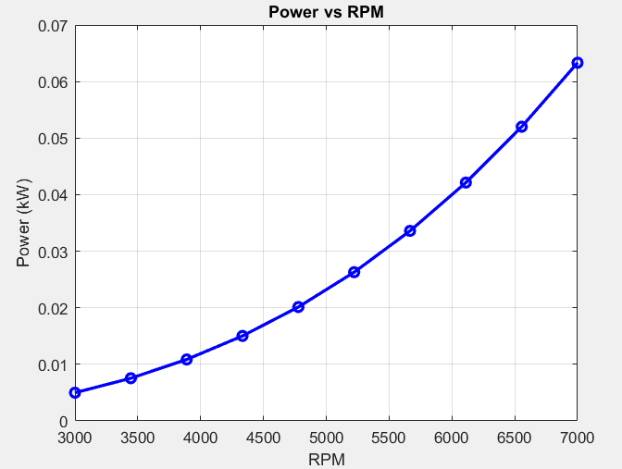
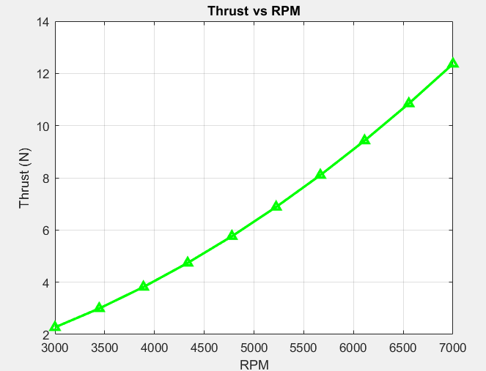
Performance Results

Slide 11
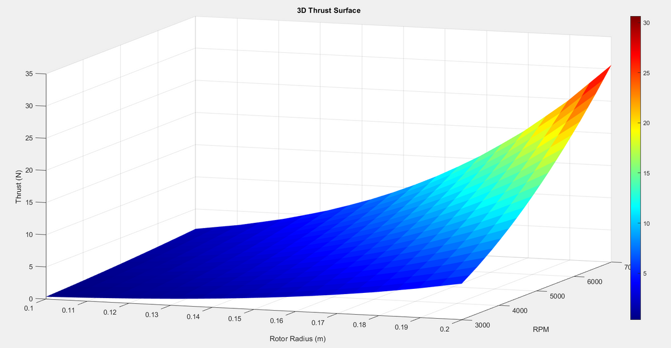
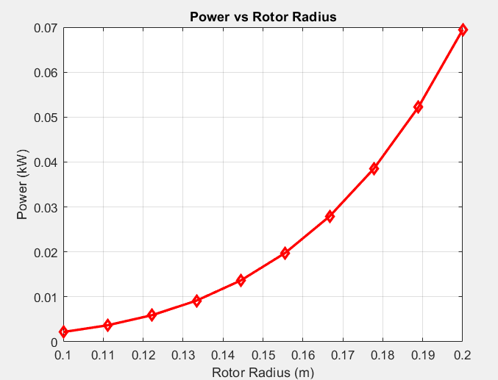
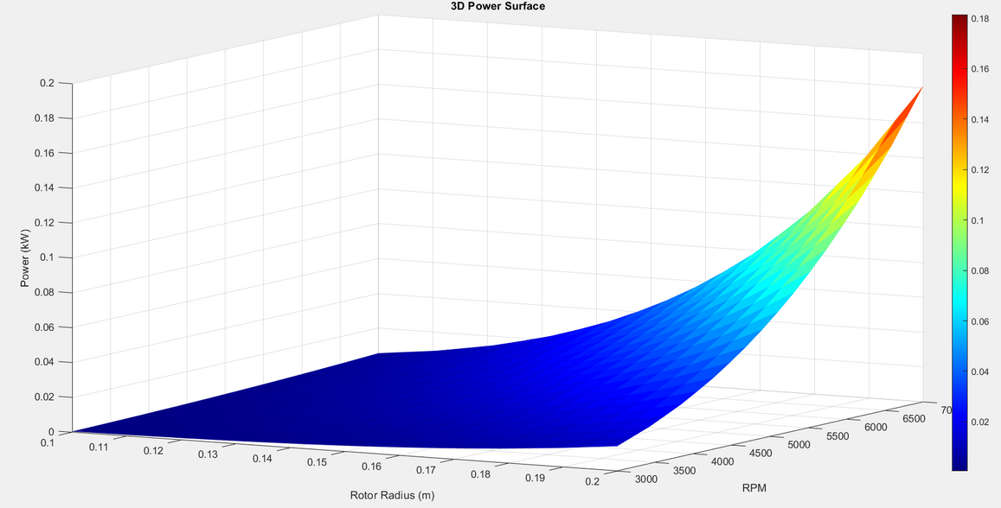

Slide 12
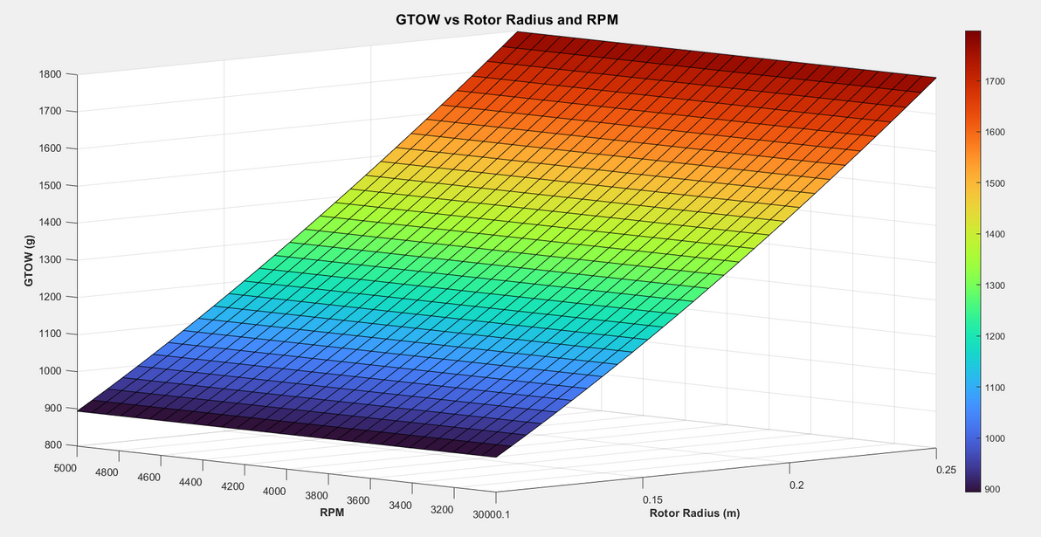
Weight Estimation
Optimized Component Weights | Optimized Component Weights
Rotor Mass each | 7.8 grams
Motor Mass each | 13.2 grams
Esc mass each | 1.321 grams
Battery Mass | 236.4 grams
Airframe Mass | 272 grams
Payload Mass | 200 grams
Total GTOW | 730 grams

Slide 13
Control Aspects of a Tricopter

Slide 14
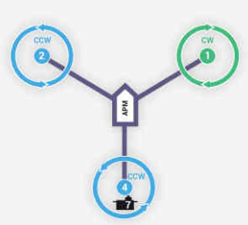
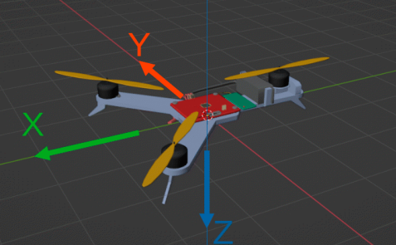
Physical Modelling
NED Coordinate system has been implemented
Assumption : Thrust forces and rotational moments generated by individual motors are proportional to the square of the motor speed values
Servo is used on the tail to balance the gyroscopic moments generated by the motor movements during operations.
Without servo the tricopter will rotate minimally around its axis while hovering
To balance all these the 2 remaining motors must rotate in opposite direction , shift the center of mass closer to the front of the tricopter such that large angle of deflection to the tail motor has been reduced
Source : Salwa, M. ,Izabela Krzysztofik. “Optimal Control for a Three-Rotor Unmanned Aerial Vehicle in Programmed Flights”. Applied Sciences, 13(24), 13118. https://doi.org/10.3390/app132413118
Source : Ardupilot.org

Slide 15
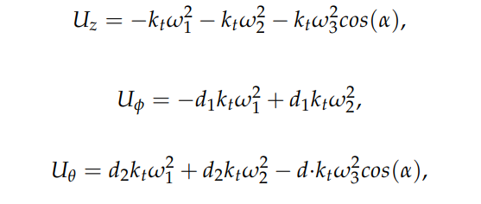
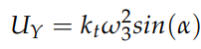
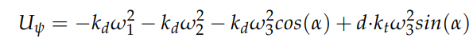
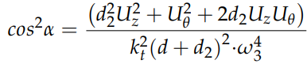
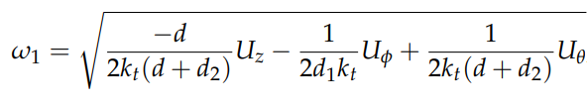

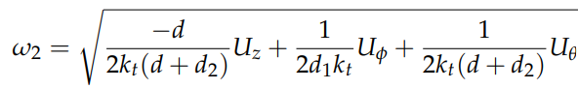



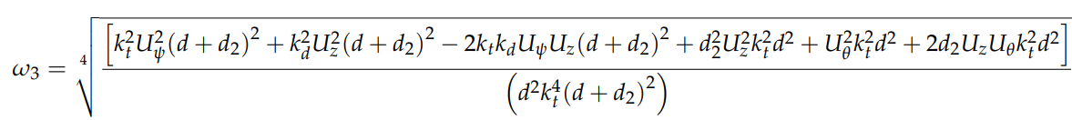


Physical Modelling
kt = Thrust coefficient
kd = Torque coefficient
alpha ( ) = angle of inclination of the tail motor
Uz = Thrust force
U = Rotation force around the x-axis
U = Rotation force around the y-axis
U =Rotation force around the z-axis
U = Force resulting from inclination of tail motor
= Motor Speed
Source : Salwa, M. ,Izabela Krzysztofik. “Optimal Control for a Three-Rotor Unmanned Aerial Vehicle in Programmed Flights”. Applied Sciences, 13(24), 13118. https://doi.org/10.3390/app132413118

Slide 16
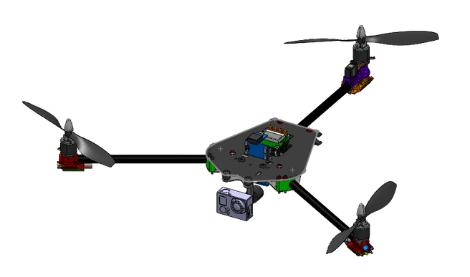


Physical Modelling
Tail Rotor
Altitude control
Roll Control
Pitch control
Yaw control

Slide 17
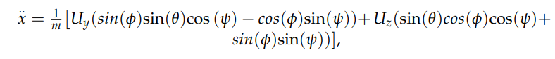
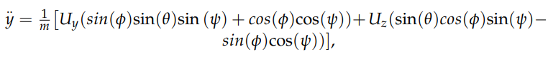
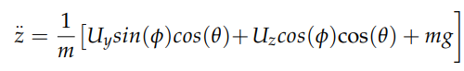
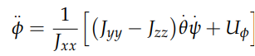
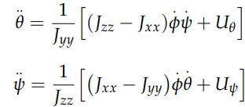
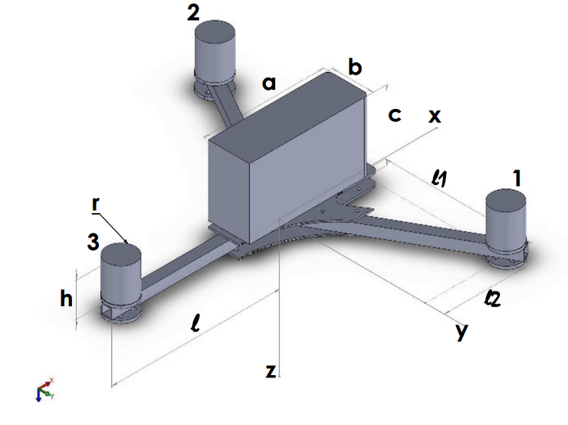
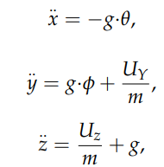
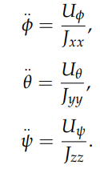
Mathematical Modelling
Equations of Motion (Non Linear)
Linearised Translational EOM
Linearised Rotational EOM

Slide 18





Control System Architecture
Z
Attitude Control
Thrust (Fz)
Zd
Control Allocation
6 DOF Tricopter Dynamics
Roll
p
Roll rate
T
X-position
x-velocity
d
d
x
1
Xd , Yd
Vxd
2
Pitch
q
Pitch rate
T
d
y
3
y-position
y-velocity
d
Vyd
d
Yaw
r
Yaw rate
T
d
z
d
[p q r]`
[ , , ]`
[Vx , Vy , ]`
[x , y , ]`
Source :

Slide 19
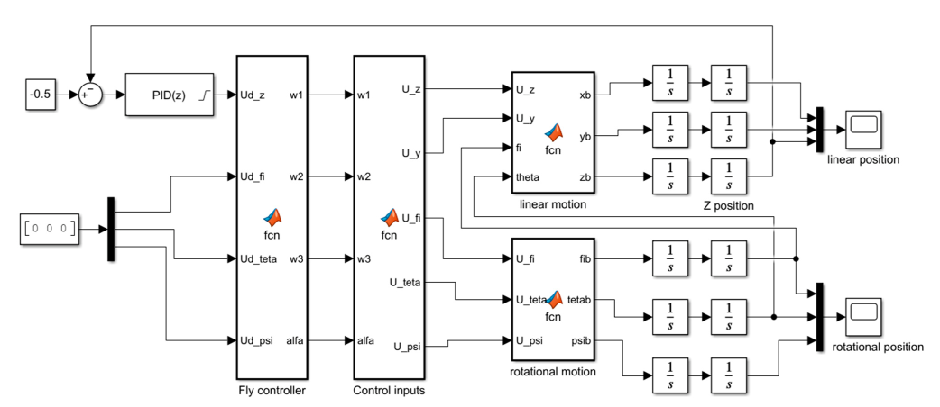
Control Design in Simulink

Slide 20
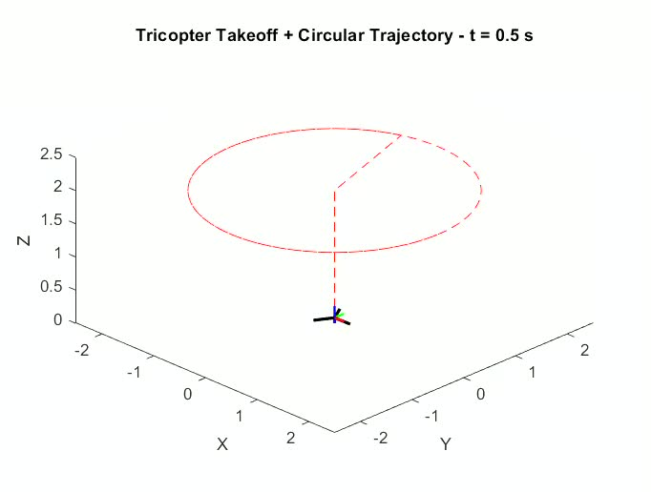
Animation & Results
Circular Trajectory

Slide 21
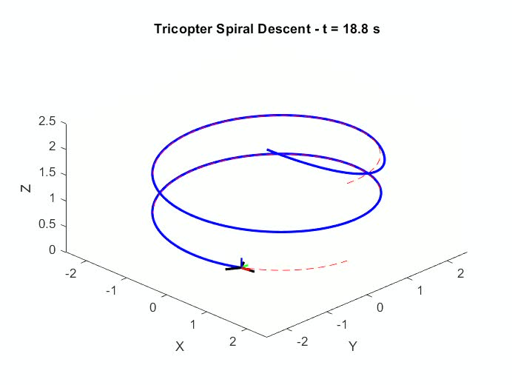
Animation & Results
Spiral Trajectory

Slide 22
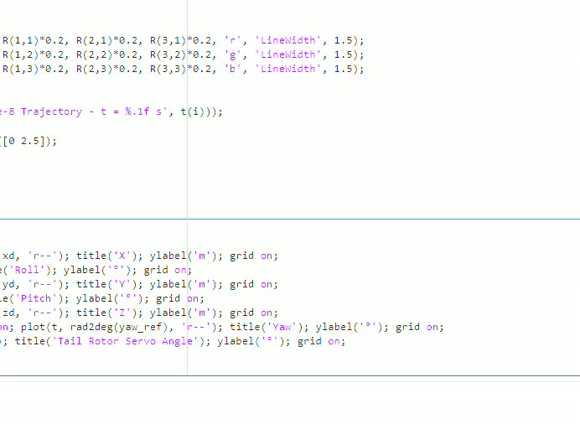
Animation & Results
Figure 8 Maneuver

Slide 23
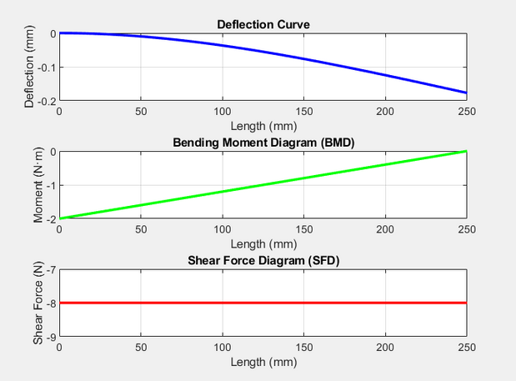
Structural Analysis of Tricopter
Hand Calculation
Using equilibrium equation to calculation deflection of a cantilever beam
P
Given :
P = 8 N , length = 250 mm , diameter = 16 mm
Formula used :
Deflection : δ=PL³ / (3*E*I)
Moment of Inertia : I=πD⁴/(64)
Bending Stress : σ=M*R​/I
L
L : Arm Length
P : Force acting on the beam
Results :
Moment of Inertia (I): 3.2170e-09 m^4
Maximum Deflection at Free End: 0.1772 mm
Maximum Bending Moment at Fixed End: 2.00 N·m

Slide 24
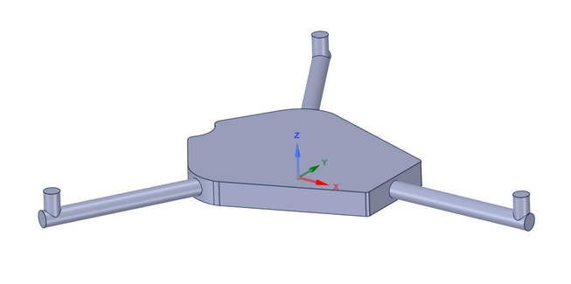
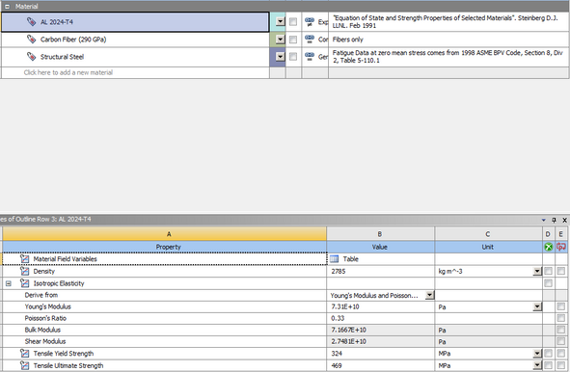
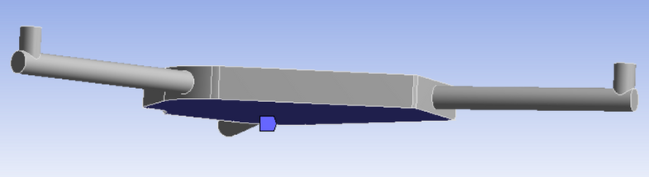
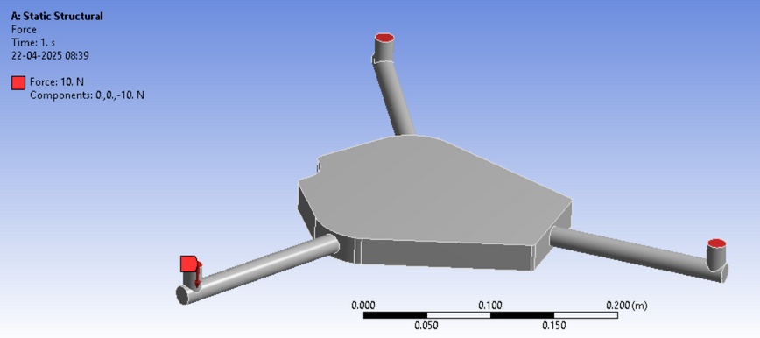
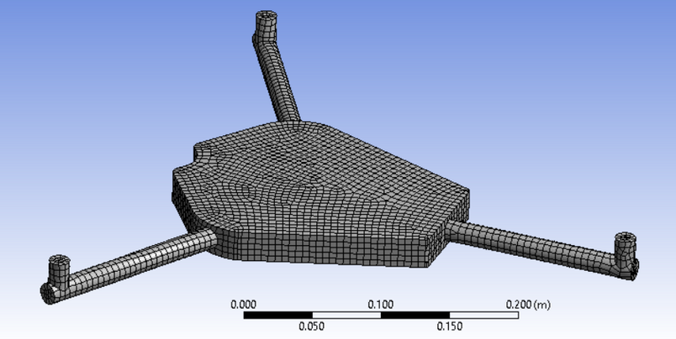
Structural Analysis of Tricopter
Geometry Creation , Boundary Conditions & Meshing
Creation of solid body in solidworks/spaceclaim
Boundary Condition : Fixed Support at the bottom
Assigning of Material Properties
Boundary Condition : Force acting at the placed motor of 10 N
Meshed Part

Slide 25
Mesh Criteria
Mesh Parameter | Value
Nodes | 388996
Elements | 94485
Orthogonal Quality | Min : 0.054 Max : 0.999 Average : 0.813
Jacobian Ratio | Min : 1 Max : 12.25 Average : 1.77
Aspect Ratio | Min : 1.001 Max : 15.12 Average : 2.47

Slide 26
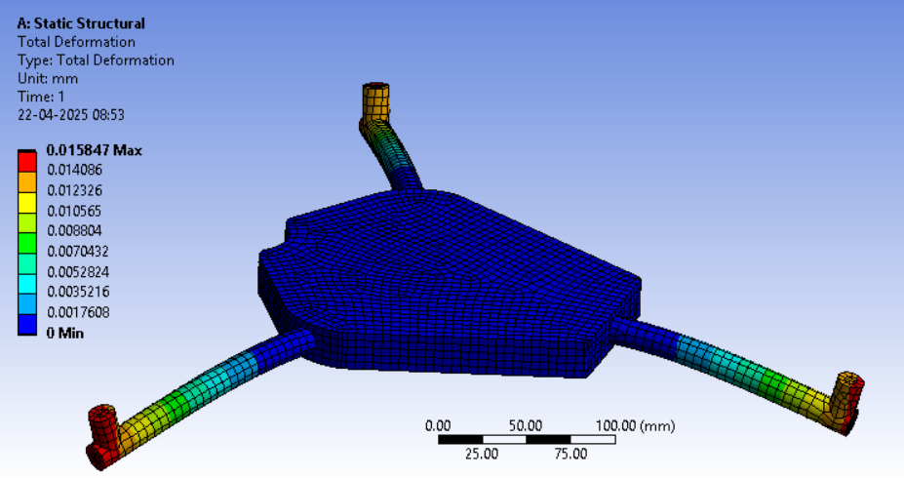
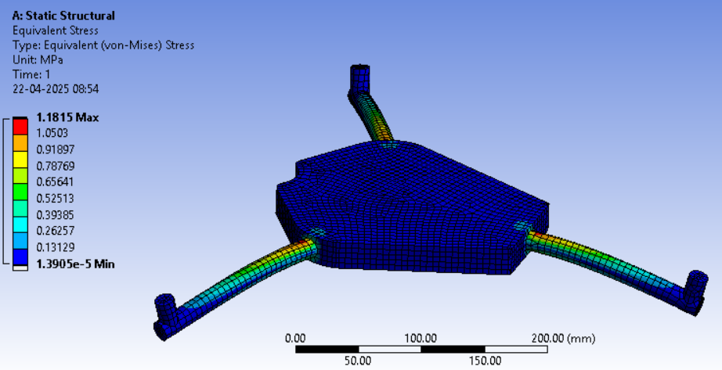
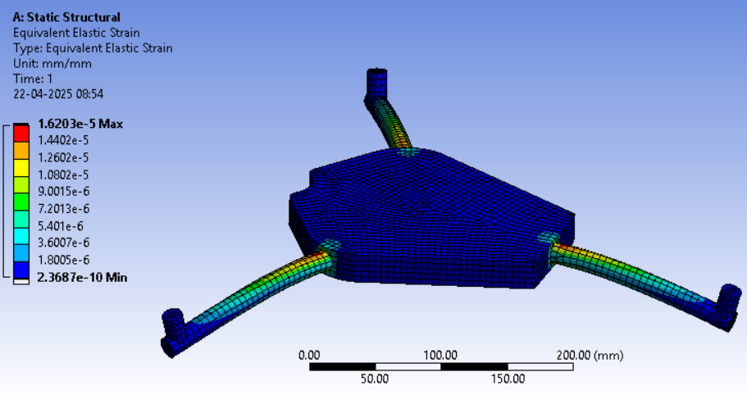
Static Structural Results
Total Deformation
Von Mises Stress
Von Mises Strain

Slide 27
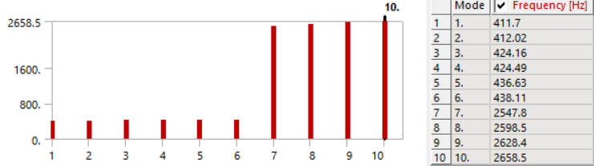
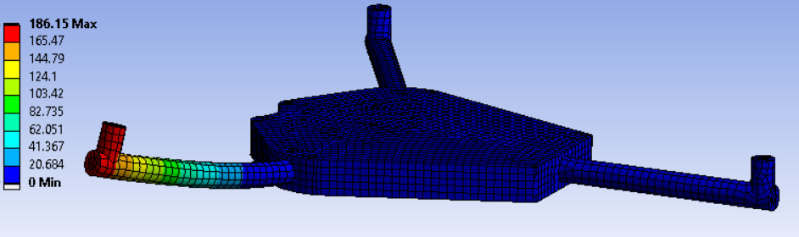
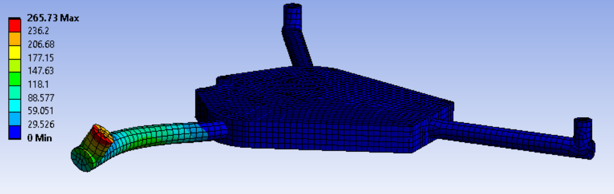
Modal Analysis
First 10 mode frequency for the same boundary condition of fixed support
Bending Mode at frequency 411.7 Hz
Torsional Mode at frequency 438.11 Hz
These are the natural frequency of the given body and the boundary conditions , since its a whole solid body the natural frequency tend to increase .

Slide 28
Conclusion
A preliminary design involving the performance , control and structural aspects of tricopter was introduced.
Different trajectories and response was shown in the control design of the tricopter which would be required since the application involved is such.
Basic structural aspect from hand calculation to the FEM analysis was shown and how it affects the result was discussed.

Slide 29
Things that can be improved
Structural Analysis of a hollow components of tricopter
Ground effect and Wind model addition in the controller design
Performance code validation through CFD
Addition of filters to the control design to depict more accurate response .

Slide 30
Softwares/Tools used
Solidworks - (CAD Design)
OpenVSP - Initial Sketch Configuration
ANSYS - Static Structural & Modal Analysis
MATLAB , Simulink - Flight Controls
XFLR5 for airfoil analysis

Slide 31
THANK YOU

